Slide 1

Sit-Stand Solutions
May, 2019

Slide 2
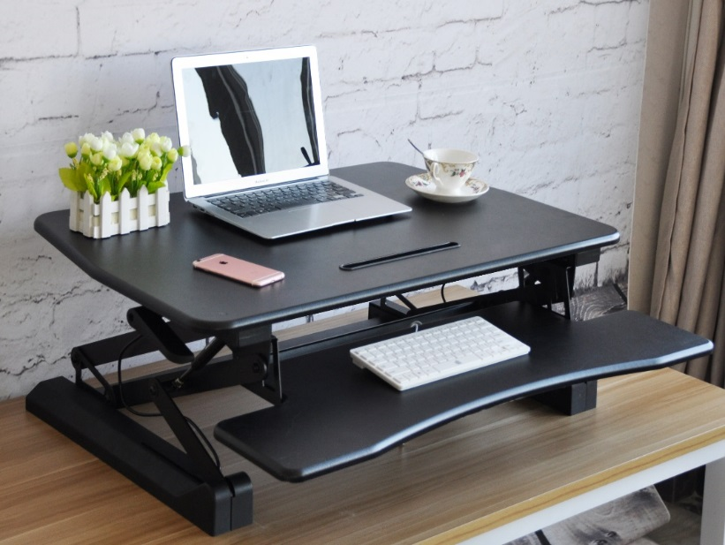
The Home Office Space is Changing
The days of cavernous desks and massive file cabinets are coming to an end. Documents that used to take up so much space are now stored digitally. More people work from home than ever before, with or without a dedicated home office. Cubicle walls are coming down as work spaces become more collaborative and as more people become connected socially and digitally. Cell phones and personal electronics are a part of our lifestyle, and we expect our workplaces to cater to them.
What people want is more functionality, more mobility, and more connectivity from their desks--at home and at work.
Seville Classics' line of height-adjustable desks aim to address this shift in home/office trends by offering several standing desks in different form factors while targeting price points that meet the needs of a wide swath of consumers.
Yes, the office space is changing. Change with it. Choose Seville Classics.

Slide 3

Consumer Workspace Trends
Home Office Furniture is Expected to be Multifunctional
Most American's don't have a dedicated home office, but they do have a designated space for "doing work" that's often split between other tasks. Desks need to be more than just a glorified laptop stand. They have to be strong with features (like height adjustability and tilting functions) that support their personal lives.
How many consumers have a workspace in their home?
25% have designated home office in their home
66% wish they had one
Of those that don’t have a designated workspace…
15% use their living rooms
12% use kitchens
10% use bedrooms
9% use dining room
14% say they don’t need it
12% prefer to work throughout the house
Most Popular Non-Work Related Workspace Pastimes
64% Browse/shop online
62% Manage household expenses
Other favorites include crafting, studying, laundry folding, gaming and more

Slide 4
Consumer Workspace Trends
Personal Electronics Compatibility is Key
Charging functionality and multi-functional tables are what people are considering when they think of "home office" furniture. People want products that support their use of personal electronics.
30% of polled customers responded that would definitely or very likely purchase furniture, a stand or mount to house a computing device.
60% of polled customers think devices with charging capability are more attractive than they did a year ago, and that trend is moving upward.
Less Bulky, Traditional Storage; More Lifestyle Focused Storage
Modern consumers are less interested in desks with large, file-oriented, built-in storage due to the home computing revolution. As a result, the kind of storage and features that people want are changing. Home office furniture needs to connect with the consumers' lifestyle and taste. Support for technology is important: USB/Wireless charging, keyboard trays, laptop risers, PC cages and cable management are key points.
Mobility, Accessibility, Portability
The ability to work in multiple spaces of a home, or even in different areas of an office building, can be valuable for people with a need for a portable workspace. More over, the mobility and adjustability of a desk is important to older and disabled users who use them near furniture like wheelchairs and beds.
Influence from Schools and Millennials
The younger generation is less concerned with formality in their personal and professional worlds and like the freedom and collaborative environment enabled by mobile workspaces. Desk carts allow people to work together easily.

Slide 5
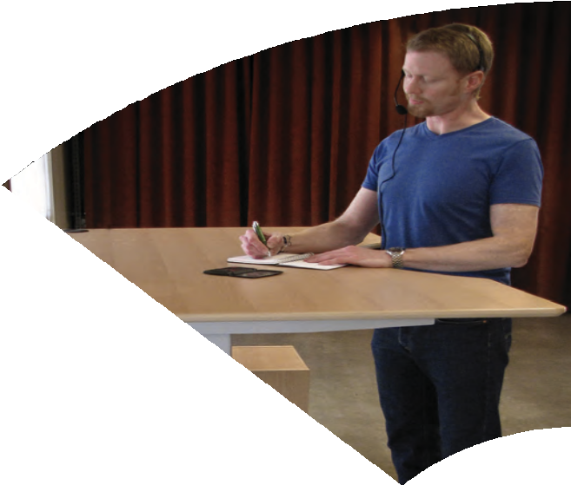
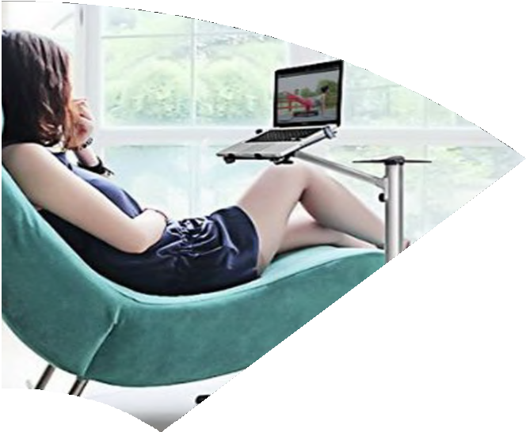
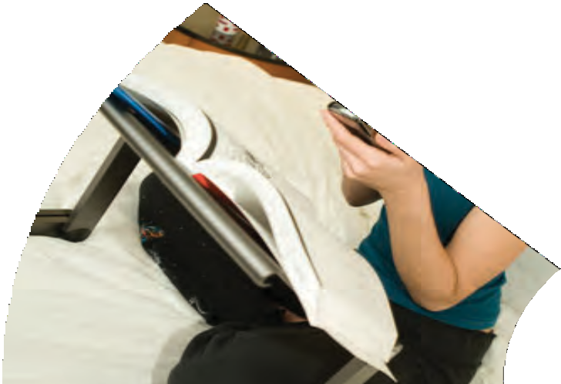



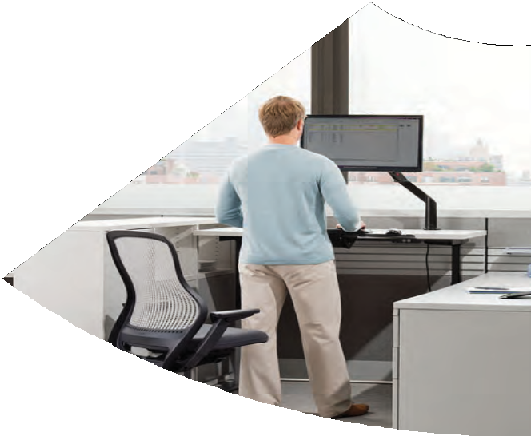
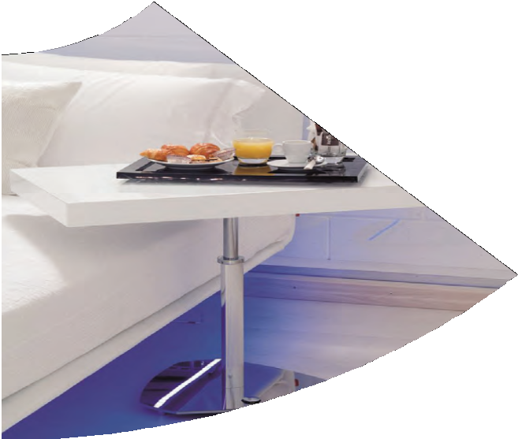
How We Use Our Desks
Watching
Writing
Painting / Designing
Reading
Usage
Presenting
Other
Eating
Computing

Slide 6
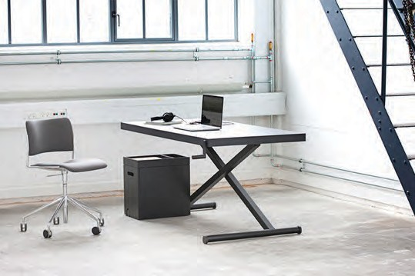
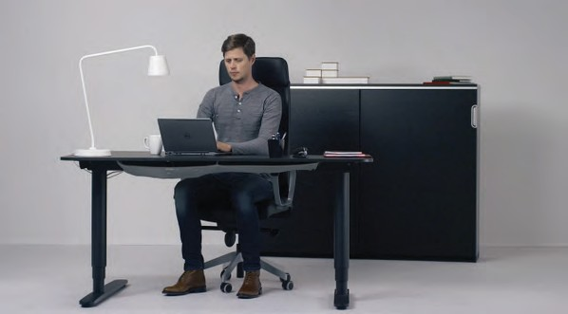
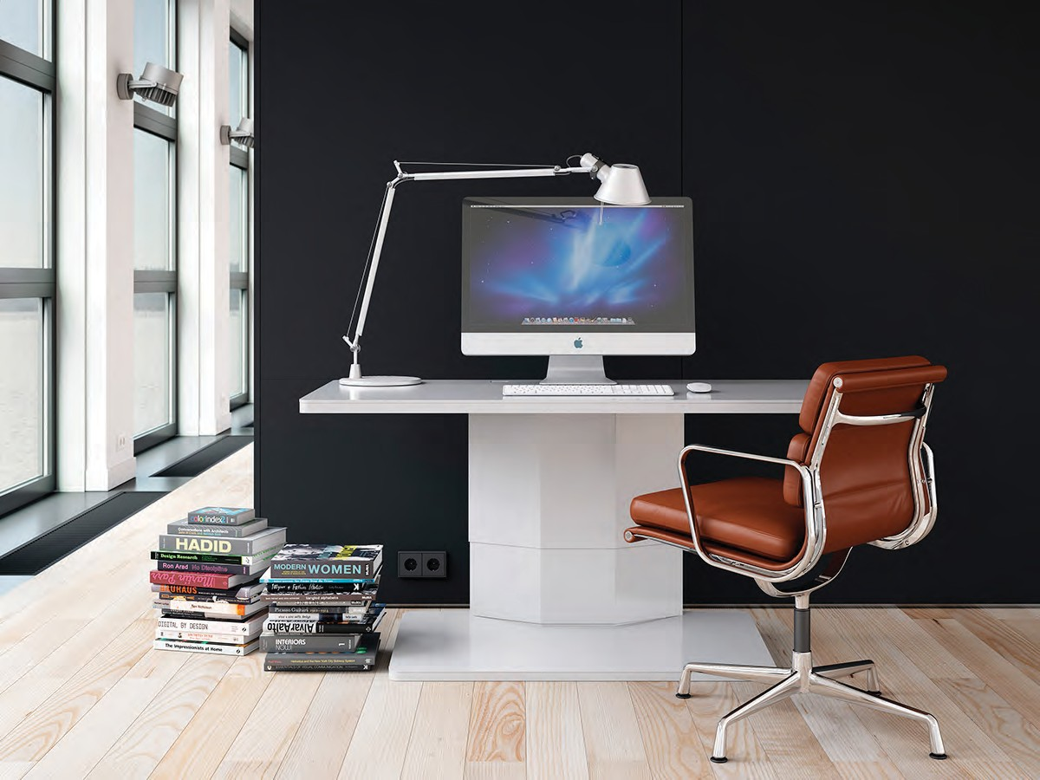
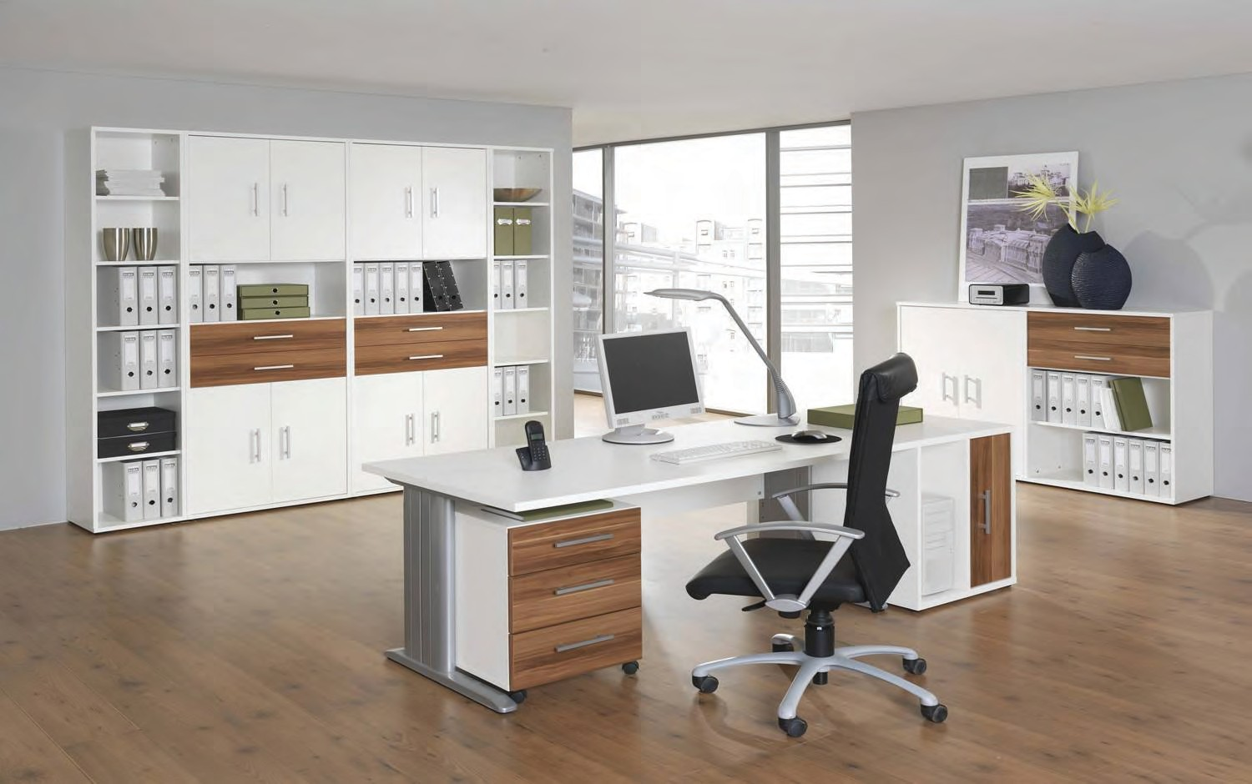
Target Environment: Home Office

Slide 7
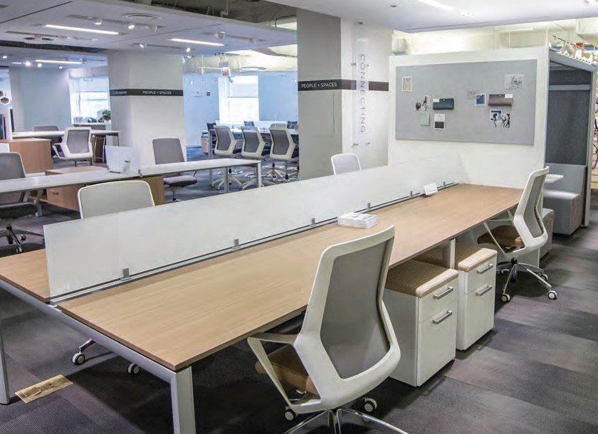
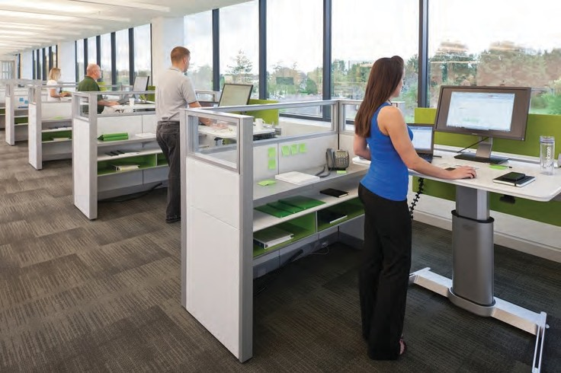
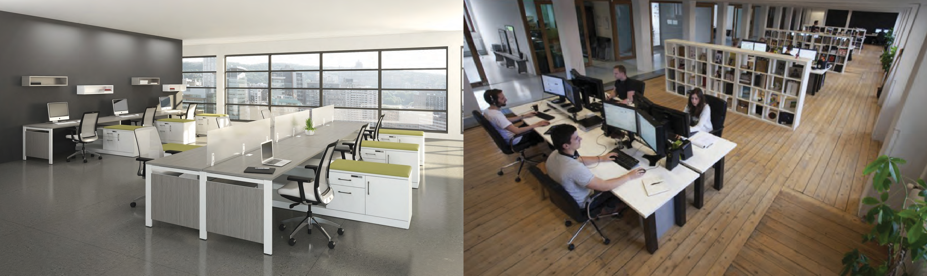
Target Environment: Commercial Office

Slide 8
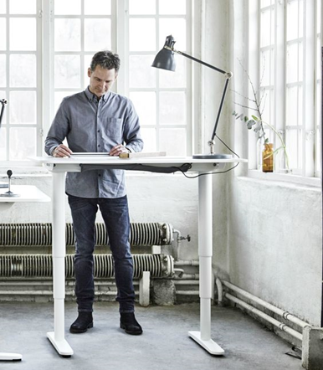
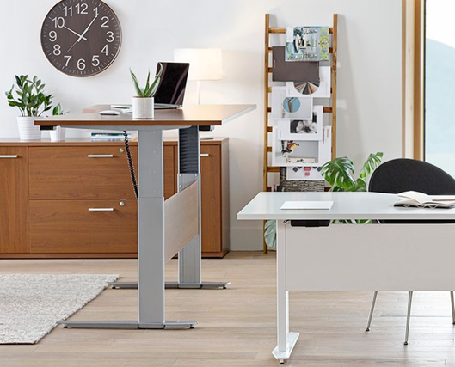
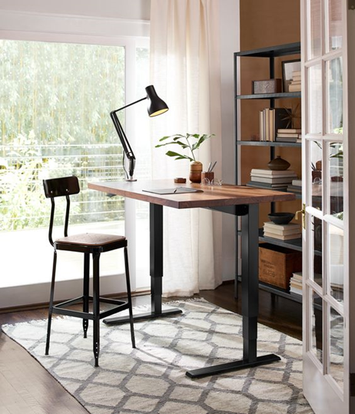
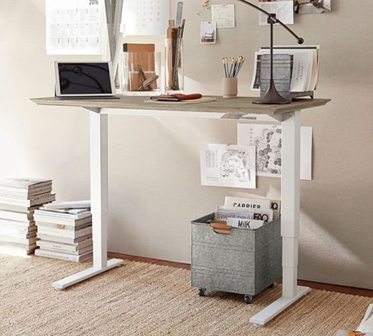
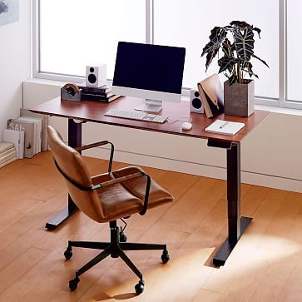
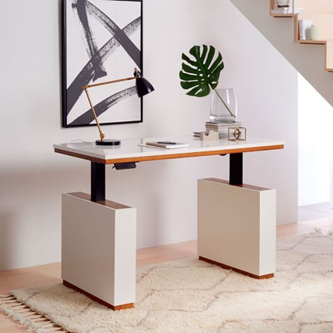
Design Trends

Slide 9
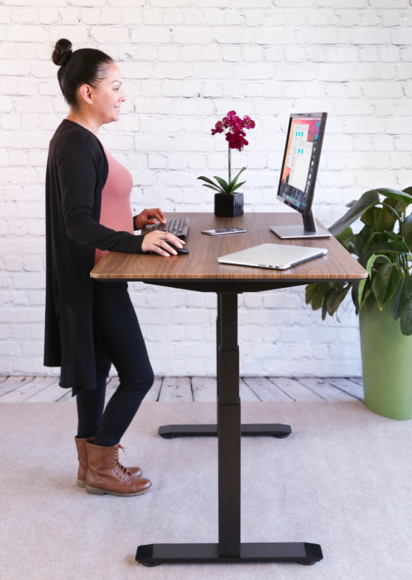
Electric Standing Desks

Slide 10
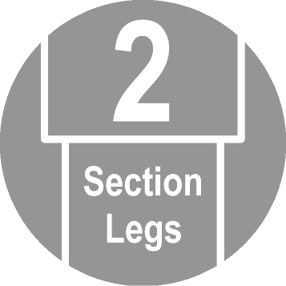
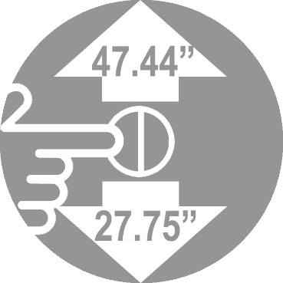
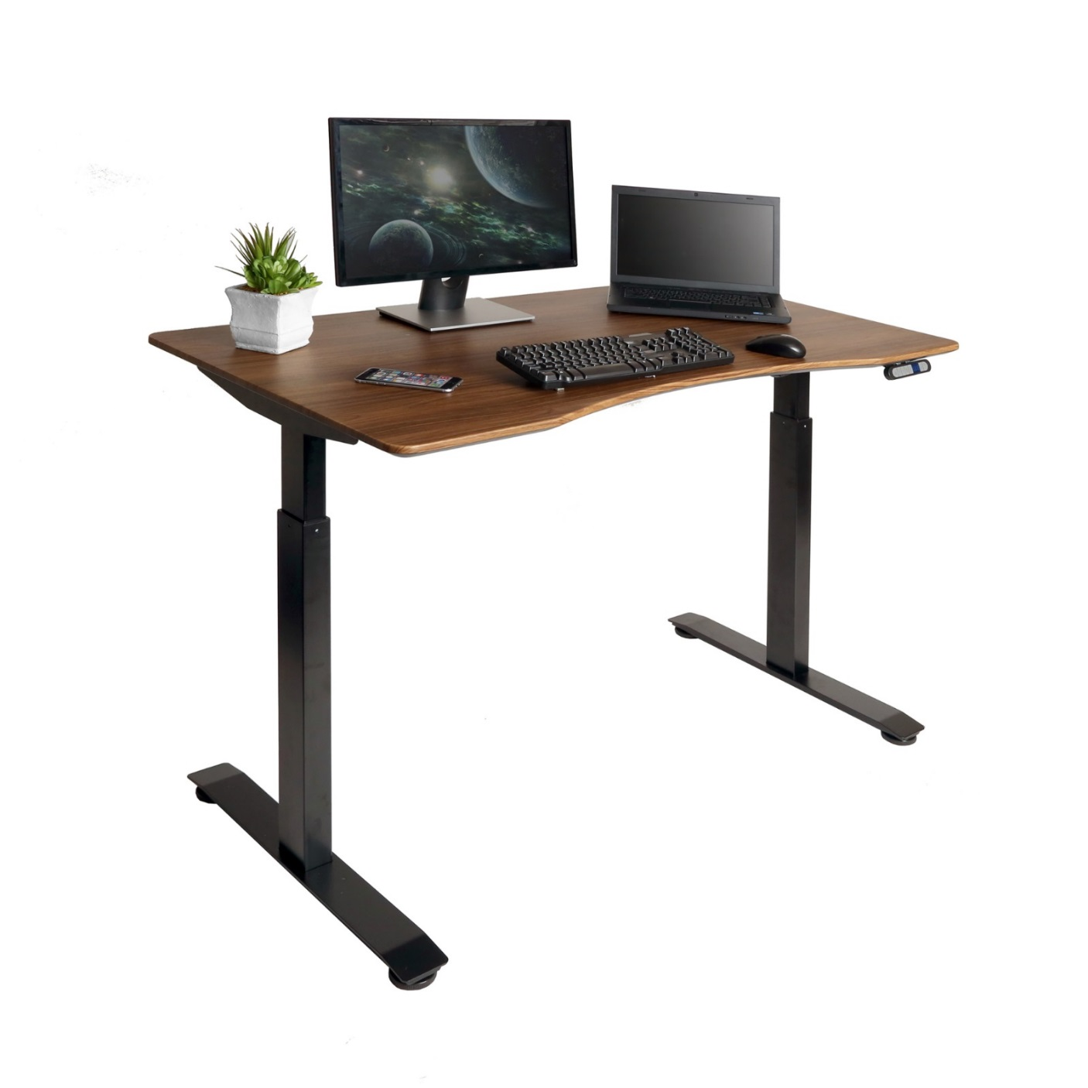

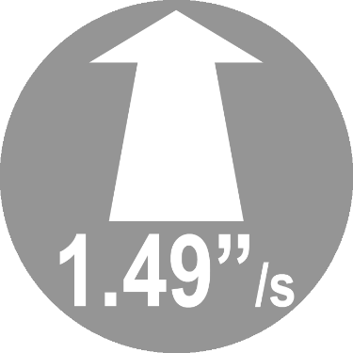

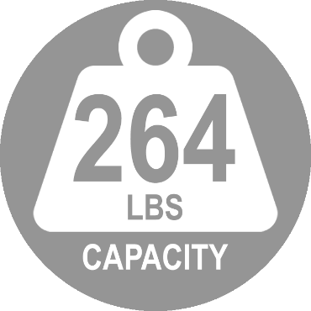
Model : OFF65802
MSRP: $399.99
Available in Torrance October 2017 (base only)
AIRLIFT® S2 Electric Height-Adjustable Standing Desk

Slide 11
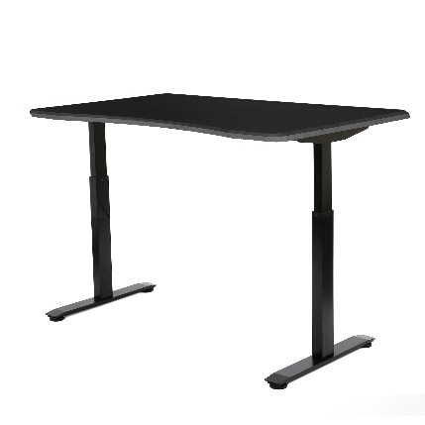
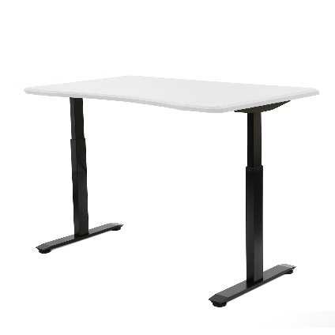
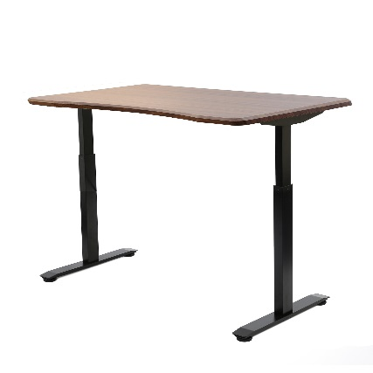
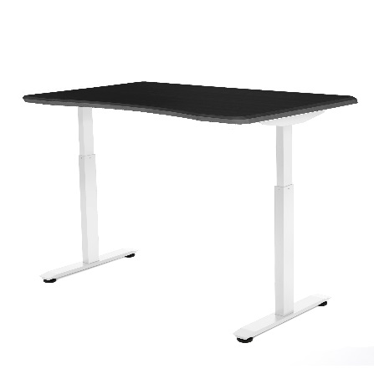
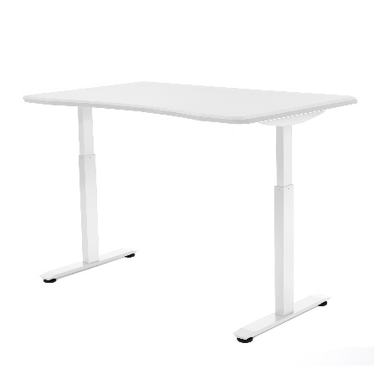
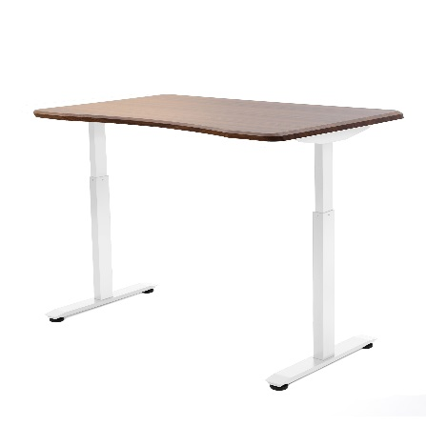
MSRP: $499.99
AIRLIFT® S2 Electric Height-Adjustable Standing Desk
(BASE + TOP)
Fast Two-Section Frame
Telescoping steel base adjusts from 28.7 to 48.4 inches high while providing a sturdy foundation.
Ergonomic Desktop Design
Top measures 54 inches wide and features a curved side for a spacious, user-focused work surface.
Powerful Dual Motors
Provide smooth and even movement when adjusting the top. A weight capacity of 264 lbs. and an adjustment rate of 1.49 inches per second, you don't have to sacrifice speed or strength.
Digital Keypad /w Memory
Save up to four height settings on the digital controller and adjust the table precisely throughout the day.
Black/Black
OFF65816
Black/White
OFF65820
Black/Walnut
OFF65824
White/Black OFF65817
White/White OFF65821
White/Walnut
OFF65825

Slide 12
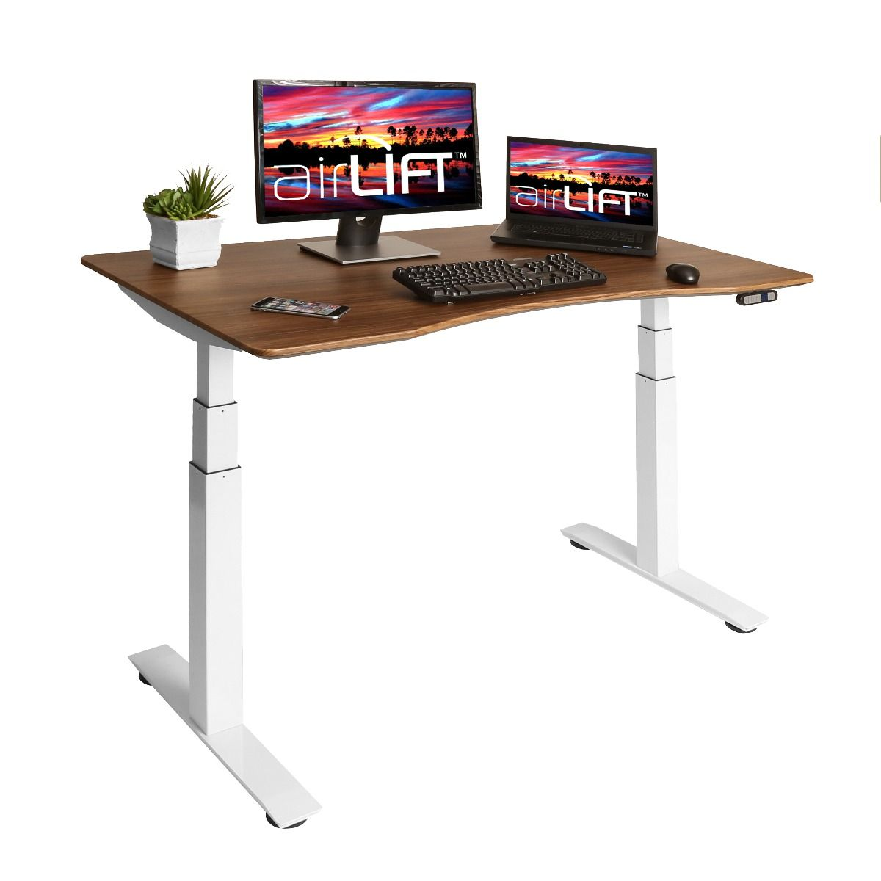
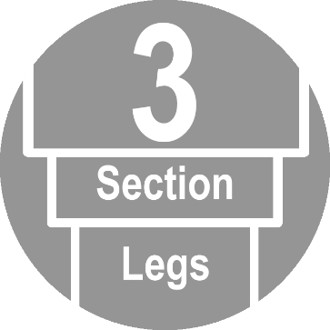
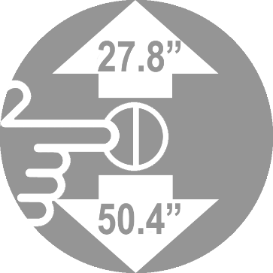
Model : OFF65803
MSRP: $429.99
Available in Torrance October 2017 (base only)
AIRLIFT® S3 Electric Height-Adjustable Standing Desk

Slide 13
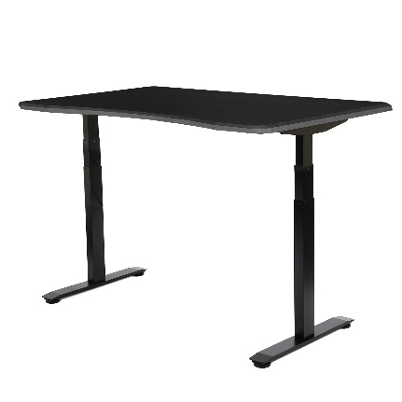
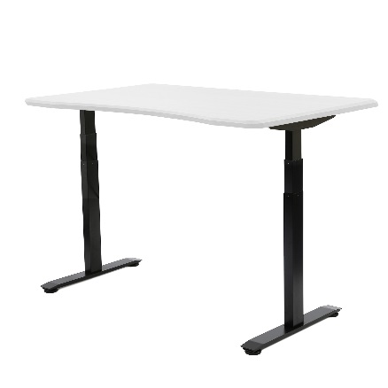
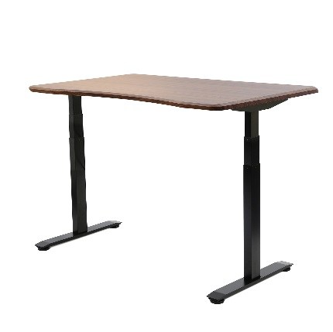
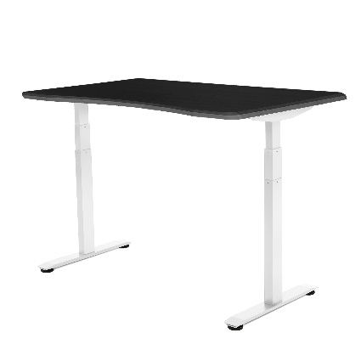
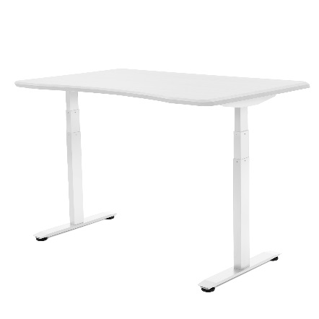
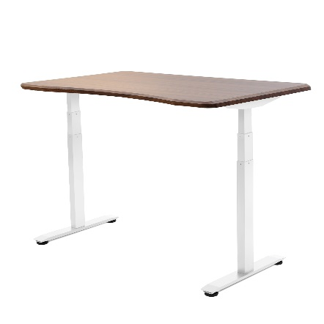
MSRP: $529.99
AIRLIFT® S3 Electric Height-Adjustable Standing Desk (BASE + TOP)
Fast Three-Section Frame
Rise higher and go lower with the three-section frame. The extra section allows the desk to dip as low as 24.8 inches high and rise to a height of 50.4 inches high at a speedy 1.49 inches per second.
Enjoy the ergonomic advantage of a standing desk no matter your height.
Ergonomic Desktop Design
Top measures 54 inches wide and features a curved side for a spacious, user-focused work surface.
Powerful Dual Motors
Provide smooth and even movement when adjusting the top. A weight capacity of 264 lbs. and an adjustment rate of 1.49 inches per second, you don't have to sacrifice speed or strength.
Digital Keypad /w Memory
Save up to four height settings on the digital controller and adjust the table precisely throughout the day.
Black/Black
OFF65818
Black/White
OFF65822
Black/Walnut
OFF65826
White/Black OFF65819
White/White OFF65823
White/Walnut
OFF65827

Slide 14
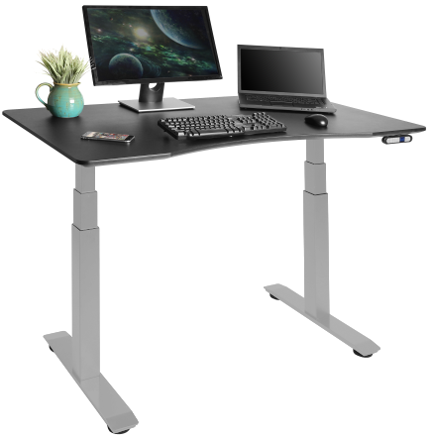
Model: OFFK65875 MSRP: $529.99
AIRLIFT® AIRLIFT S3 Electric Desk with Gray Frame + Black Top
Fast Three-Section Frame
Rise higher and go lower with the three-section frame. The extra section allows the desk to dip as low as 24.8 inches high and rise to a height of 50.4 inches high at a speedy 1.49 inches per second.
Enjoy the ergonomic advantage of a standing desk no matter your height.
Ergonomic Desktop Design
Top measures 54 inches wide and features a curved side for a spacious, user-focused work surface.
Powerful Dual Motors
Provide smooth and even movement when adjusting the top. A weight capacity of 264 lbs. and an adjustment rate of 1.49 inches per second, you don't have to sacrifice speed or strength.
Digital Keypad /w Memory
Save up to four height settings on the digital controller and adjust the table precisely throughout the day.

Slide 15
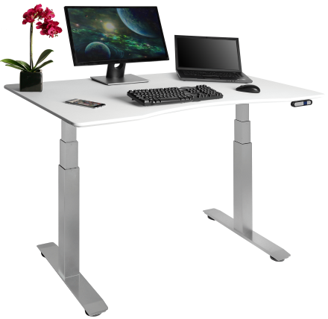
Model: OFFK65877 MSRP: $529.99
AIRLIFT® AIRLIFT S3 Electric Desk with Gray Frame + White Top
Fast Three-Section Frame
Rise higher and go lower with the three-section frame. The extra section allows the desk to dip as low as 24.8 inches high and rise to a height of 50.4 inches high at a speedy 1.49 inches per second.
Enjoy the ergonomic advantage of a standing desk no matter your height.
Ergonomic Desktop Design
Top measures 54 inches wide and features a curved side for a spacious, user-focused work surface.
Powerful Dual Motors
Provide smooth and even movement when adjusting the top. A weight capacity of 264 lbs. and an adjustment rate of 1.49 inches per second, you don't have to sacrifice speed or strength.
Digital Keypad /w Memory
Save up to four height settings on the digital controller and adjust the table precisely throughout the day.

Slide 16
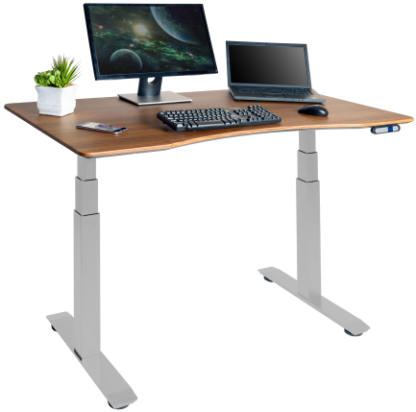
Model: OFFK65876 MSRP: $529.99
AIRLIFT® AIRLIFT S3 Electric Desk with Gray Frame + Walnut Top
Fast Three-Section Frame
Rise higher and go lower with the three-section frame. The extra section allows the desk to dip as low as 24.8 inches high and rise to a height of 50.4 inches high at a speedy 1.49 inches per second.
Enjoy the ergonomic advantage of a standing desk no matter your height.
Ergonomic Desktop Design
Top measures 54 inches wide and features a curved side for a spacious, user-focused work surface.
Powerful Dual Motors
Provide smooth and even movement when adjusting the top. A weight capacity of 264 lbs. and an adjustment rate of 1.49 inches per second, you don't have to sacrifice speed or strength.
Digital Keypad /w Memory
Save up to four height settings on the digital controller and adjust the table precisely throughout the day.

Slide 17
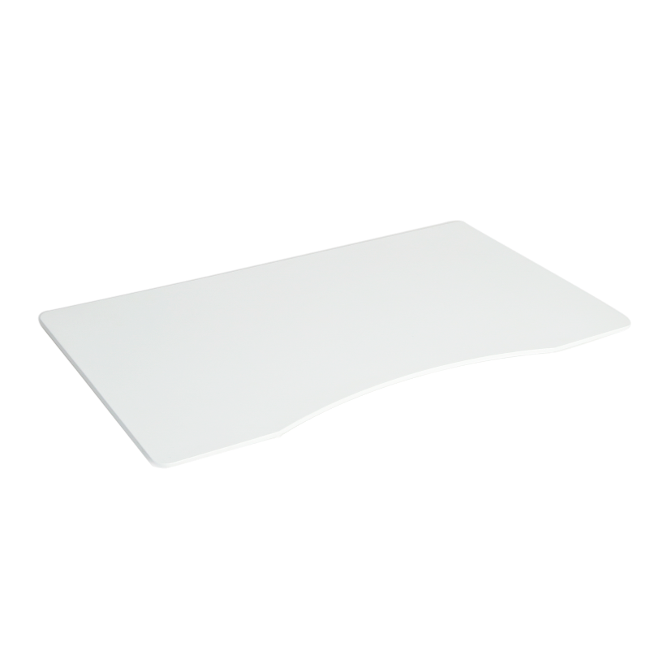
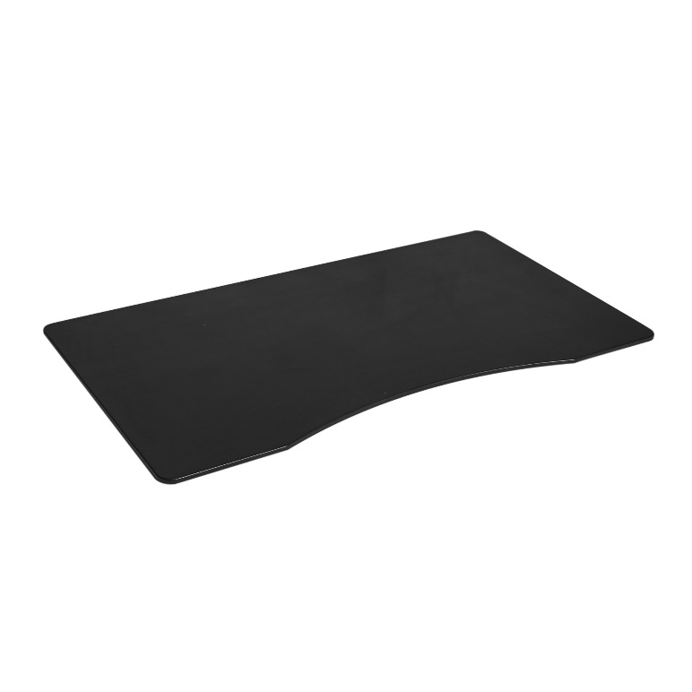
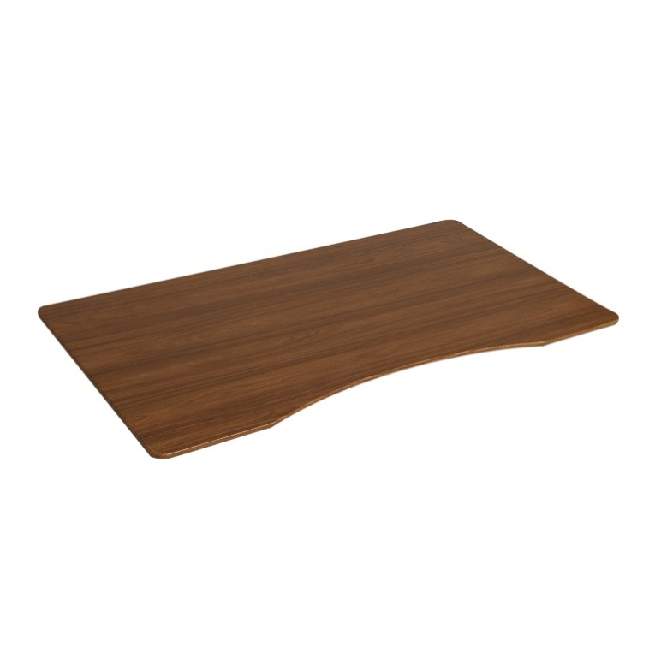
MSRP: $119.99
Ergo Desktop Table Top with Beveled Bottom Edges, 54" x 30", Black
Black
OFF65811
White
OFF65812
Walnut
OFF65813
Beveled Edges Desk edges feature an inward bevel for user comfort, allowing users to lower the desk further and pull in closer, comfortably.
Durable Construction Designed to be lightweight and tough, the top is constructed from wood and sealed in black, white, or walnut laminate.
Ergonomic Curve Curved desk top allows users to stand closer to the table while working. Enjoy a more "you" focused workspace.

Slide 18
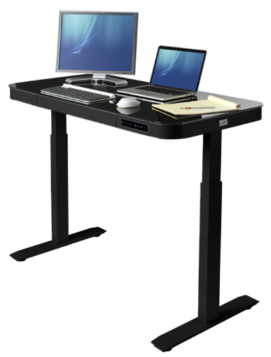
Model: OFF65871/WEB611 MSRP: $399.99
Coming November 2018
AIRLIFT® Height Adjustable Electric Desk with Glass Top + Dual USB Charger, Black/Black
Features
Convenient size designed for home offices, bedrooms and apartments
Touchscreen controller with 3 memory settings let multiple users store their ideal height settings easily
Dual 2.4A USB ports quickly charge iPads and power-hungry devices
Single drawer features two compartments to organize your workspace
Top is available in a variety of materials and finishes
Steel frame construction for strength and durability
Adjustable leveling feet for stability on any surface
Assembly is easy with only a few parts
Specifications
Top Material: Tempered glass
Top Area: 48" W x 24" D x 2.75" H
Adjustment Type: Dual electric motors
Adjustment Range: 29" to 47" H
Overall Size: 47" W x 24" D (29" to 47" H)
Frame material: Steel

Slide 19
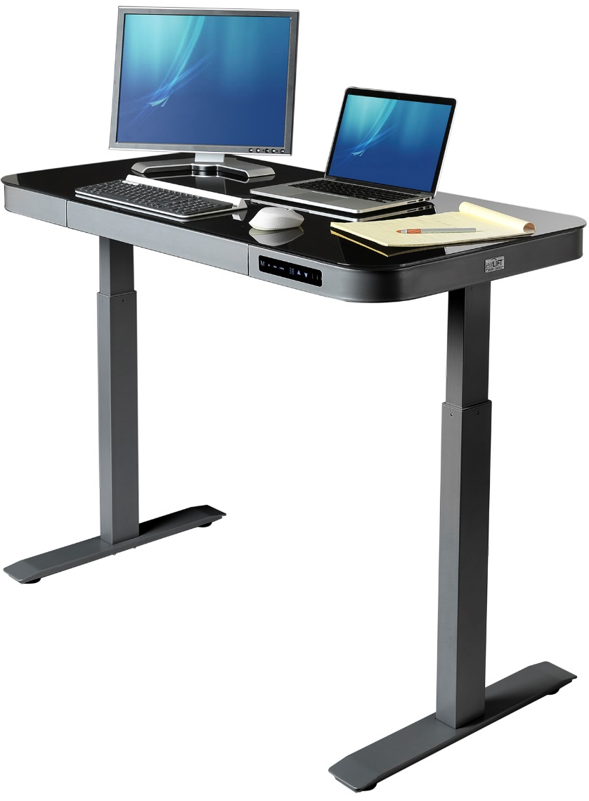
Model: OFF65872/WEB612 MSRP: $399.99
Coming November 2018
AIRLIFT® Height Adjustable Electric Desk with Glass Top + Dual USB Charger, Black/Gray
Features
Convenient size designed for home offices, bedrooms and apartments
Touchscreen controller with 3 memory settings let multiple users store their ideal height settings easily
Dual 2.4A USB ports quickly charge iPads and power-hungry devices
Single drawer features two compartments to organize your workspace
Top is available in a variety of materials and finishes
Steel frame construction for strength and durability
Adjustable leveling feet for stability on any surface
Assembly is easy with only a few parts
Specifications
Top Material: Tempered glass
Top Area: 48" W x 24" D x 2.75" H
Adjustment Type: Dual electric motors
Adjustment Range: 29" to 47" H
Overall Size: 47" W x 24" D (29" to 47" H)
Frame material: Steel

Slide 20
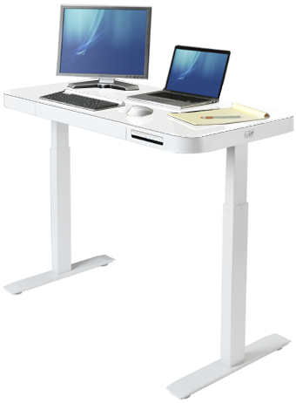
Model: OFF65873/WEB613 MSRP: $399.99
Coming November 2018
AIRLIFT® Height Adjustable Electric Desk with Glass Top + Dual USB Charger, White/White
Features
Convenient size designed for home offices, bedrooms and apartments
Touchscreen controller with 3 memory settings let multiple users store their ideal height settings easily
Dual 2.4A USB ports quickly charge iPads and power-hungry devices
Single drawer features two compartments to organize your workspace
Top is available in a variety of materials and finishes
Steel frame construction for strength and durability
Adjustable leveling feet for stability on any surface
Assembly is easy with only a few parts
Specifications
Top Material: Tempered glass
Top Area: 48" W x 24" D x 2.75" H
Adjustment Type: Dual electric motors
Adjustment Range: 29" to 47" H
Overall Size: 47" W x 24" D (29" to 47" H)
Frame material: Steel

Slide 21

Desk-on-Desk Standing Desk

Slide 22
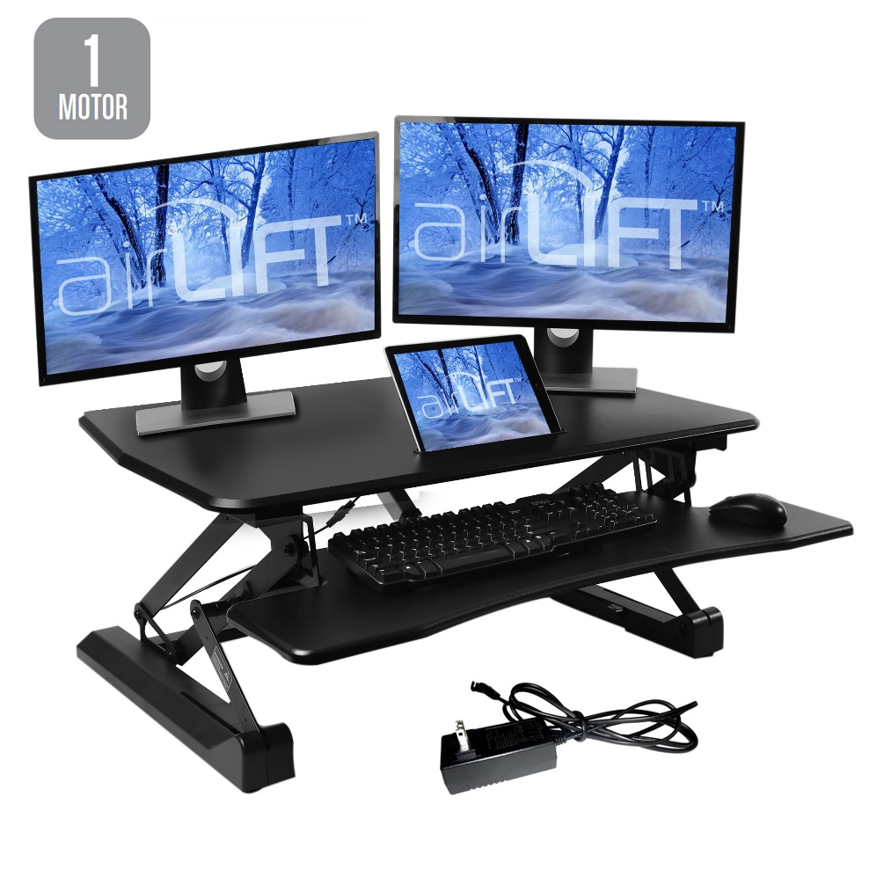


Model: OFF65806
MSRP: $269.99
AIRLIFT® 35" Electric Sit Stand Desktop Workstation Converter Desk
Features
Turns any flat surface into an adjustable height workspace
Provides more than 11 inches of vertical height adjustment!
Electric drive system lifts up to 33 lbs. with the touch of a button
5V2.1A/10W USB port charges USB devices from phone chargers, to mini fans and other gadgets
Generous desk top surface measures 35.43" x 23.23"; fits almost any size laptop and multiple monitor setups
Conveniently store tablets and cell phones in the desk top slot for easy access and use as a second screen
Ergonomically beveled edges provide a comfortable resting place for the heel of your hand
Removable keyboard tray adjusts with desk top
No assembly required; simply unpack and plug in
Specifications
Top Material: Technical wood with laminate finish
Top Area: 35.43" x 23.23" x 0.59" thick
Color: Black
Frame Color: Black
Adjustment Type: Electric Motor
Adjustment Range: 5.9" to 18.9"
Overall Size: 35.43" W x 23.23" D x (5.9” to 18.9") H
Weight Capacity: 33 lbs.
Weight: 50.7 lbs.

Slide 23






Features
Button-Operated Height-Adjustment
Single 2.1A USB Charger
Integrated Tablet Stand

Slide 24

Model: OFF65807
MSRP: $199.99
AIRLIFT® 35" Gas-Spring Sit Stand Desktop Workstation Converter Desk, Black
Features
Turns any flat surface into an adjustable height workspace
Pneumatic and spring system lifts up to 33 lbs. smoothly
Provides nearly 13.8 inches of vertical height adjustment!
Generous desk top surface measures 35.43" x 23.23"; fits almost any size laptop and multiple monitor setups
Conveniently store tablets and cell phones in the desk top slot for easy access and use as a second screen
Self contained design saves space by adjusting height vertically
Ergonomically beveled edges provide a comfortable resting place for the heel of your hand
Removable keyboard tray adjusts with desk top
No assembly, no buttons, no plugs; simply unpack and work
Specifications
Top Material: MDF wood with laminate finish
Top Area: 35.43" x 23.23" x 0.59" thick
Top Color: White
Frame Color: Silver
Adjustment Type: Pneumatic
Adjustment Range: 5.9" to 19.7"
Overall Size: 35.43" W x 23.23' D x (5.9" to 19.7") H
Weight Capacity: 33 lbs.
Weight: 52.3 lbs.

Slide 25

Model: OFF65808
MSRP: $199.99
AIRLIFT® 35" Gas-Spring Sit Stand Desktop Workstation Converter Desk, White
Features
Turns any flat surface into an adjustable height workspace
Pneumatic and spring system lifts up to 33 lbs. smoothly
Provides nearly 13.8 inches of vertical height adjustment!
Generous desk top surface measures 35.43" x 23.23"; fits almost any size laptop and multiple monitor setups
Conveniently store tablets and cell phones in the desk top slot for easy access and use as a second screen
Self contained design saves space by adjusting height vertically
Ergonomically beveled edges provide a comfortable resting place for the heel of your hand
Removable keyboard tray adjusts with desk top
No assembly, no buttons, no plugs; simply unpack and work
Specifications
Top Material: MDF wood with laminate finish
Top Area: 35.43" x 23.23" x 0.59" thick
Top Color: White
Frame Color: Silver
Adjustment Type: Pneumatic
Adjustment Range: 5.9" to 19.7"
Overall Size: 35.43" W x 23.23' D x (5.9" to 19.7") H
Weight Capacity: 33 lbs.
Weight: 52.3 lbs.

Slide 26

Model: OFF65840
MSRP: $199.99
AIRLIFT® 35" Gas-Spring Sit Stand Desktop Workstation Converter Desk, Walnut
Features
Turns any flat surface into an adjustable height workspace
Pneumatic and spring system lifts up to 33 lbs. smoothly
Provides nearly 13.8 inches of vertical height adjustment!
Generous desk top surface measures 35.43" x 23.23"; fits almost any size laptop and multiple monitor setups
Conveniently store tablets and cell phones in the desk top slot for easy access and use as a second screen
Self contained design saves space by adjusting height vertically
Ergonomically beveled edges provide a comfortable resting place for the heel of your hand
Removable keyboard tray adjusts with desk top
No assembly, no buttons, no plugs; simply unpack and work
Specifications
Top Material: MDF wood with laminate finish
Top Area: 35.43" x 23.23" x 0.59" thick
Top Color: White
Frame Color: Silver
Adjustment Type: Pneumatic
Adjustment Range: 5.9" to 19.7"
Overall Size: 35.43" W x 23.23' D x (5.9" to 19.7") H
Weight Capacity: 33 lbs.
Weight: 52.3 lbs.

Slide 27

Model: OFF65869 MSRP: $229.99
AIRLIFT® 43" Gas-Spring Corner Standing Desk Converter Riser, Black
Features
Tapered desk top is perfect for corners and small spaces.
Pneumatic and spring system lifts up to 33 lbs. smoothly
Provides nearly 13.8 inches of vertical adjustment!
Generous desk top surface measures 43.3" x 23.6"
Fits perfectly into any corner space
Self contained design saves space by adjusting height vertically, staying in the same footprint
Ergonomically beveled edges provide a comfortable resting place for the heel of your hand
Removable keyboard tray adjusts with desk top
No assembly, no buttons, no plugs
Specifications
Top Material: MDF with laminate finish
Top Area: 43.3" x 23.6" x 0.59" thick
Top Color: Black
Frame Color: Silver
Adjustment Type: Pneumatic
Adjustment Range: 5.9" to 19.7"
Overall Size: 43.3" W x 31.1" D x (5.9" to 19.7") H
Weight Capacity: 33 lbs.
Weight: 52.3 lbs.

Slide 28

Model: OFF65870 MSRP: $229.99
AIRLIFT® 43" Gas-Spring Corner Standing Desk Converter Riser, Walnut
Features
Tapered desk top is perfect for corners and small spaces.
Pneumatic and spring system lifts up to 33 lbs. smoothly
Provides nearly 13.8 inches of vertical adjustment!
Generous desk top surface measures 43.3" x 23.6"
Fits perfectly into any corner space
Self contained design saves space by adjusting height vertically, staying in the same footprint
Ergonomically beveled edges provide a comfortable resting place for the heel of your hand
Removable keyboard tray adjusts with desk top
No assembly, no buttons, no plugs
Specifications
Top Material: MDF with laminate finish
Top Area: 43.3" x 23.6" x 0.59" thick
Top Color: Black
Frame Color: Silver
Adjustment Type: Pneumatic
Adjustment Range: 5.9" to 19.7"
Overall Size: 43.3" W x 31.1" D x (5.9" to 19.7") H
Weight Capacity: 33 lbs.
Weight: 52.3 lbs.

Slide 29




Model: OFF65841
MSRP: $179.99
AIRLIFT® 30" Gas-Spring Standing Desk Converter Workstation with Pullout Keyboard Tray
Features
Turns any flat surface into an adjustable height workspace
Provides 11 inches of vertical height adjustment!
Compact desk top surface measures 30.7" x 20.5"; fits almost any size laptop and multiple monitor setups
Retractable keyboard tray slides in and out as needed
Aluminum frame keeps the desk lightweight
Ergonomic design moves towards you as it rises
No assembly, no buttons, no plugs; simply unpack and work
Rubber padded base prevents moving when in use
Specifications
Top Material: MDF with laminate finish
Height Adjustment Range: 6.9" to 17.9"
Top Area: 30.7" W x 20.5" D
Keyboard Tray Size: 29.1" x 9.44" D
Top Color: Slate Gray
Frame Color: Silver
Frame Material: Aluminum
Adjustment Type: Pneumatic
Overall Size: 30.7" x (20.5" to 27.2") x (6.9" to 17.9")
Base Size: 18" x 19"
Weight: 48.4 lbs.

Slide 30

Model: OFF65864
MSRP: $149.99
AIRLIFT® 25" Gas-Spring Height Adjustable Standing Desk Converter Workstation
Features
Turns any flat surface into an adjustable height workspace
Compact desk top surface measures 25.2" x 17.9"; fits almost any size laptop and multiple monitor setups
Aluminum frame keeps the desk lightweight
No assembly, no buttons, no plugs; simply unpack and work
Rubber padded base prevents moving when in use
Specifications
Top Material: MDF with laminate finish
Top Area: 25.2" x 17.9"
Keyboard Tray Size: 25.2" x 10.6"
Top Color: Black
Frame Color: Black
Frame Material: Steel
Adjustment Type: Pneumatic

Slide 31

Model: OFF65843
MSRP: $129.99
AIRLIFT® Slim Laptop Desk Converter Riser, White
Extended handles with locking AIRLIFT® levers
Features
Turns any flat surface into an adjustable height workspace
Extended handles make the desk easy to hold, move and carry
Enjoy 12 levels of height adjustment up to 15.7 inches high
Steel frame provides stability and strength
Generous desk top surface measures 31.3" x 21.3"; fits almost any size laptop and multiple monitor setups
Ultra-slim frame and desktop design
Self contained design saves space by adjusting height vertically
No assembly, no buttons, no plugs; simply unpack and work
Specifications
Top Material: MDF
Top Area: 31.3" x 21.3"
Top Color: White
Frame Color: Silver
Adjustment Type: Pneumatic
Adjustment Range: 1.2" to 15.7"
Overall Size: 31.3" W x 21.3" D x (1.2" to 15.7") H
Weight: 23.59 lbs.
Weight Capacity: 22 lbs.
12-step pneumatic height adjustment

Slide 32

Model: OFF65842
MSRP: $129.99
AIRLIFT® Slim Laptop Desk Converter Riser, Black
Extended handles with locking AIRLIFT® levers
Features
Turns any flat surface into an adjustable height workspace
Extended handles make the desk easy to hold, move and carry
Enjoy 12 levels of height adjustment up to 15.7 inches high
Steel frame provides stability and strength
Generous desk top surface measures 31.3" x 21.3"; fits almost any size laptop and multiple monitor setups
Ultra-slim frame and desktop design
Self contained design saves space by adjusting height vertically
No assembly, no buttons, no plugs; simply unpack and work
Specifications
Top Material: MDF
Top Area: 31.3" x 21.3"
Top Color: Black
Frame Color: Black
Adjustment Type: Pneumatic
Adjustment Range: 1.2" to 15.7"
Overall Size: 31.3" W x 21.3" D x (1.2" to 15.7") H
Weight: 23.59 lbs.
Weight Capacity: 22 lbs.
12-step pneumatic height adjustment

Slide 33


Manual Sit-Stand Desks

Slide 34

Model: WEB162
MSRP: $34.99
Mobile Laptop Computer Desk Cart, Walnut
Features
Lift and lower the desk manually by turning a knob
Generous working surface suitable for use as a laptop desk, art station or a TV/reading table
Scratch-resistant woodgrain desk top
A wide, rectangular, metal base provides excellent stability while in motion and at rest
Low-profile base for easy use near furniture like couches
Assembly is easy with only a few parts; no drilling required
Four 1.5-inch casters (2 locking) allow your work to travel with you anywhere in the office or at home
Specifications
Top Material: MDF wood with laminate finish
Top Area: 23.6" W x 15.74" D
Adjustment Type: Manual
Adjustment Range: 20.47" to 33" H
Overall Size: 23.6" W x 15.74" D x (20.47" to 33") H
Weight Capacity: 15 lbs.

Slide 35

Model: OFF65854
MSRP: $39.99
Mobile Laptop Computer Desk Cart, Black
Features
Lift and lower the desk manually by turning a knob
Generous working surface suitable for use as a laptop desk, art station or a TV/reading table
Scratch-resistant woodgrain desk top
A wide, rectangular, metal base provides excellent stability while in motion and at rest
Low-profile base for easy use near furniture like couches
Assembly is easy with only a few parts; no drilling required
Four 1.5-inch casters (2 locking) allow your work to travel with you anywhere in the office or at home
Specifications
Top Material: MDF wood with laminate finish
Top Area: 23.6" W x 15.74" D
Adjustment Type: Manual
Adjustment Range: 20.47" to 33" H
Overall Size: 23.6" W x 15.74" D x (20.47" to 33") H
Weight Capacity: 15 lbs.

Slide 36

Model: OFF65855
MSRP: $39.99
Mobile Laptop Computer Desk Cart, White
Features
Lift and lower the desk manually by turning a knob
Generous working surface suitable for use as a laptop desk, art station or a TV/reading table
Scratch-resistant woodgrain desk top
A wide, rectangular, metal base provides excellent stability while in motion and at rest
Low-profile base for easy use near furniture like couches
Assembly is easy with only a few parts; no drilling required
Four 1.5-inch casters (2 locking) allow your work to travel with you anywhere in the office or at home
Specifications
Top Material: MDF wood with laminate finish
Top Area: 23.6" W x 15.74" D
Adjustment Type: Manual
Adjustment Range: 20.47" to 33" H
Overall Size: 23.6" W x 15.74" D x (20.47" to 33") H
Weight Capacity: 15 lbs.

Slide 37



Model: WEB344
MSRP: $49.99
Tilting Mobile Laptop Desk Cart, Walnut
Features
Tilt the angle of the tabletop for a more natural working position while typing, writing or drawing
Ledge prevents work from sliding off the table when tilted
Lift and lower the desk manually by turning a knob
Scratch-resistant desk top
Low-profile base for easy use near furniture like couches
Wide, steel base ensures wobble-free use
Four 2-inch casters (2 locking) allow your work to travel with you anywhere in the office or at home.
Specifications
Top Material: MDF wood with laminate finish
Top Area: 23.6" W x 20.5" D
Adjustment Type: Manual
Adjustment Range: 23.62" to 36.41" H
Overall Size: 23.6" W x 20.5" D x (23.6" to 36.4" H)
Weight Capacity: 15 lbs.

Slide 38



Model: WEB361
MSRP: $49.99
Tilting Mobile Laptop Desk Cart, Black
Features
Tilt the angle of the tabletop for a more natural working position while typing, writing or drawing
Ledge prevents work from sliding off the table when tilted
Lift and lower the desk manually by turning a knob
Scratch-resistant desk top
Low-profile base for easy use near furniture like couches
Wide, steel base ensures wobble-free use
Four 2-inch casters (2 locking) allow your work to travel with you anywhere in the office or at home.
Specifications
Top Material: MDF wood with laminate finish
Top Area: 23.6" W x 20.5" D
Adjustment Type: Manual
Adjustment Range: 23.62" to 36.41" H
Overall Size: 23.6" W x 20.5" D x (23.6" to 36.4" H)
Weight Capacity: 15 lbs.

Slide 39



Model: WEB234
MSRP: $49.99
Sit-Stand Desk Cart with Side Table
Features
Side table mounts to either side of the desk
Tilt the angle of the tabletop for a more natural working position while typing, writing or drawing
Ledge prevents work from sliding off the table when tilted
Lift and lower the desk manually by turning a knob
Scratch-resistant woodgrain desk top
Low-profile base for easy use near furniture like couches
Wide, steel base ensures wobble-free use
Four 1.5-inch casters (2 locking) allow your work to travel with you anywhere in the office or at home
Specifications
Top Material: MDF wood with laminate finish
Main Table Area: 17.75" W x 15.75" D
Side Table Area: 8.3" W x 9.8" D
Adjustment Type: Manual
Adjustment Range: 27.9" to 40.7" H
Overall Size: 27.9" W x 15.9" D x (27.9" to 40.7") H
Weight Capacity: 20 lbs.

Slide 40

Pneumatic Sit-Stand Desks

Slide 41

Model: OFF42630
MSRP: $99.99
AIRLIFT® Pneumatic Laptop Mobile Desk Cart
Features
Large desktop with maple woodgrain print
Beveled desktop edges with rounded corners
Effortless pneumatic height adjustment with lever-operated gas-air cylinder
Steel frame powder-coated in dark brown epoxy
Wide rectangular base provides wobble-free use
Four 2.36-inch casters (2 locking) make it easy to take your work with you
Specifications
Top Material: MDF wood with laminate finish
Top Area: 24.4" W x 16.9" D
Top Color: Maple
Frame Color: Dark Brown
Adjustment Type: Pneumatic
Adjustment Range: 29.3" to 43.5" H
Overall Size: 24.4" W x 16.9" D x (29.3" to 43.5" H)
Weight Capacity: 35 lbs.
AIRLIFT® Adjustment Lever

Slide 42

Model: OFF65800
MSRP: $179.99
AIRLIFT® XL Sit-Stand Mobile Desk, Espresso
Features
Extra-large desktop with smooth surface
Effortless pneumatic height adjustment with lever-operated gas-air cylinder
Steel base and aluminum column coated in silver epoxy
Wide base provides wobble-free use
Four 2.36-inch casters (2 locking) make it easy to take your work with you
Specifications
Top Material: MDF wood with laminate finish
Top Area: 28.1" W x 19.6" D
Top Color: Espresso
Frame Color: Silver
Adjustment Type: Pneumatic
Adjustment Range: 27.1" to 41.9" H
Overall Size: 28.1" W x 19.6" D x (27.1" to 41.9") H
Weight Capacity: 35 lbs.
AIRLIFT® Adjustment Lever

Slide 43

Model: OFF65801
MSRP: $179.99
AIRLIFT® XL Sit-Stand Mobile Desk, White
Features
Extra-large desktop with smooth surface
Effortless pneumatic height adjustment with lever-operated gas-air cylinder
Steel base and aluminum column coated in silver epoxy
Wide base provides wobble-free use
Four 2.36-inch casters (2 locking) make it easy to take your work with you
Specifications
Top Material: MDF wood with laminate finish
Top Area: 28.1" W x 19.6" D
Top Color: Espresso
Frame Color: Silver
Adjustment Type: Pneumatic
Adjustment Range: 27.1" to 41.9" H
Overall Size: 28.1" W x 19.6" D x (27.1" to 41.9") H
Weight Capacity: 35 lbs.
AIRLIFT® Adjustment Lever

Slide 44

Model: OFF16020
MSRP: $349.99
AIRLIFT® Height Adjustable Sit-to-Stand Table, Espresso
Features
Extra-large desktop with smooth surface
Effortless pneumatic height adjustment with lever-operated gas-air cylinder
Steel base with a silver finish
Four 2.36-inch casters (2 locking) make it easy to take your work with you
Specifications
Top Material: MDF with laminate finish
Top Area: 55.1" W x 27.6" D
Frame Color: Silver
Adjustment Type: Pneumatic
Adjustment Range: 28.1" to 43.9"
Overall Size: 55.1" W x 27.6" D x (28.1" to 43.9")

Slide 45

Model: OFF16028
MSRP: $349.99
AIRLIFT® Height Adjustable Sit-to-Stand Table, White
Features
Extra-large desktop with smooth surface
Effortless pneumatic height adjustment with lever-operated gas-air cylinder
Steel base with a silver finish
Four 2.36-inch casters (2 locking) make it easy to take your work with you
Specifications
Top Material: MDF with laminate finish
Top Area: 55.1" W x 27.6" D
Frame Color: Silver
Adjustment Type: Pneumatic
Adjustment Range: 28.1" to 43.9"
Overall Size: 55.1" W x 27.6" D x (28.1" to 43.9")

Slide 46


Model: OFF65856
MSRP: $59.99
AIRLIFT® 360 Adjustable Under-the-Desk Ergonomic Keyboard
Features
Retractable design lets users push the tray in and out
Tilt to the perfect angle for ergonomic use
Swivel to accommodate any seating position
Heavy-duty design engineered for work and home use
Aluminum and steel construction
Cushioned wrist rest helps reduce fatigue when typing
Holds up to 5 lbs.
Specifications
Material: Aluminum + Steel
Color: Black
Adjustment: Tilt +6°/-22°
Swivel: 180°
Overall Size: 25" x 20" x 3.6" (Tray measures 25" W x 9.8" D)
Weight Capacity: 5 lbs.
Weight: 9.9 lbs.

Slide 47

Model: OFF65857
MSRP: $34.99
AIRLIFT® 360 Single Adjustable Desk Mount Monitor Arm
Features
Height-adjustable for a optimal ergonomics while working
Tilt and swivel adjustment lets users position monitors as desired; switch from landscape to portrait views
Cable management system keeps desks tidy
Universal hardware pack included
Specifications
Material: Aluminum + Steel
Color: Black
Adjustment: Tilt -90°/+35°
Swivel: 180°
Rotation: 360°
Weight Capacity: 17.64 lbs. per arm
Weight: 4.4 lbs.

Slide 48

Model: OFF65858
MSRP: $39.99
AIRLIFT® 360 Dual Adjustable Desk Mount Monitor Arm
Features
Height-adjustable for a optimal ergonomics while working
Tilt and swivel adjustment lets users position monitors as desired; switch from landscape to portrait views
Cable management system keeps desks tidy
Universal hardware pack included
Specifications
Material: Aluminum + Steel
Color: Black
Adjustment: Tilt -90°/+35°
Swivel: 180°
Rotation: 360°
Weight Capacity: 17.64 lbs. per arm
Weight: 6.6 lbs.

Slide 49

Model: OFF65859
MSRP: $59.99
AIRLIFT® 360 Gas-Spring Single Adjustable Desk Mount Monitor Arm
Features
Pneumatic support lets users effortlessly position screens simply by moving them into place
Arm can fit screens from 13" to 27"
Holds monitor weighing up 17 lbs.
Perfect for LED computer monitors, 4K flat TVs, LCD screens, and other display devices
Hidden cable management reaches an integral whole with aluminum structure
Premium aluminum and steel construction
Specifications
Material: Aluminum + Steel
Color: Black
Adjustment: Tilt +'-90°~+85°
Swivel: 180°
Rotation: 360°
Weight Capacity: 17.64 lbs. per arm
Weight: 6.4 lbs.

Slide 50

Model: OFF65860
MSRP: $84.99
AIRLIFT® 360 Gas-Spring Dual Adjustable Desk Mount Monitor Arm
Features
Pneumatic support lets users effortlessly position screens simply by moving them into place
Arms can fit screens from 13" to 27"
Each arm holds up 17.64 lbs.
Position screens side-by-side or in series.
Perfect for LED computer monitors, 4K flat TVs, LCD screens, and other display devices
Hidden cable management reaches an integral whole with aluminum structure
Premium aluminum and steel construction
Specifications
Material: Aluminum + Steel
Color: Black
Adjustment: Tilt +'-90°~+85°
Swivel: 180°
Rotation: 360°
Weight Capacity: 17.64 lbs. per arm
Weight: 10.1 lbs.

Slide 51

Model: MSC55929B, MSC55930B
MSRP: $29.99
AIRLIFT® Anti-Fatigue Comfort Mat
Features
Premium 100% polyurethane construction
Viscoelastic material is able to stretch, bend, fold while returning to it's original shape
Non-slip base features ridges that keep the mat from sliding on slick and occasionally wet surfaces
Beveled edges designed to prevent tripping and accidents
Curl resistant edges keep the corners of the mat flat
Completely non-toxic!
Measures 32" x 20" .7" thick
Specifications
Material: Polyurethane foam
Top Area: 32" x 20"
Color: Black, Gray
Overall Size: 32" x 20" x .7" thick
Weight: 23 lbs. per mat
Black (MSC55929B)
Gray (MSC55930B)

Slide 52


Model: MSC55931B, MSC55932B MSRP: $54.99
AIRLIFT® Anti-Fatigue Comfort Mat (2-Pack)
Features
Premium 100% polyurethane construction
Viscoelastic material is able to stretch, bend, fold while returning to it's original shape
Non-slip base features ridges that keep the mat from sliding on slick and occasionally wet surfaces
Beveled edges designed to prevent tripping and accidents
Curl resistant edges keep the corners of the mat flat
Completely non-toxic!
Measures 32" x 20" .7" thick
Specifications
Material: Polyurethane foam
Top Area: 32" x 20"
Color: Black, Gray
Overall Size: 32" x 20" x .7" thick
Weight: 23 lbs. per mat
Black 2-Pack
(MSC55931B)
Gray 2-Pack
(MSC55932B)

Slide 53





Model: OFF65904
MSRP: $159.99
AIRLIFT® XL Sit-Stand Mobile Desk with Cup Holder, White
Features
Large tabletop with spill-proof PVC laminate finish
Quick adjustment with a squeeze of the AIRLIFT lever
Hanger hook for backpacks, bags and purses
Built-in cup holder and storage tray
Steel construction for strength and durability
Large casters (2 locking) for smooth-gliding mobility
Weight capacity: 33 lbs.
Specifications
Overall Size: 25.6" W x 21.6" D (30" to 45.6" H)
Height Adjustment Range: 30" to 45.6" H
Adjustment Type: Pneumatic
Top Material: Wood with PVC finish
Top Color: White
Frame Material: Steel
Frame Color: White
Hanger hook

Slide 54





Model: OFF6503
MSRP: $159.99
AIRLIFT® XL Sit-Stand Mobile Desk with Cup Holder, Black
Features
Large tabletop with spill-proof PVC laminate finish
Quick adjustment with a squeeze of the AIRLIFT lever
Hanger hook for backpacks, bags and purses
Built-in cup holder and storage tray
Steel construction for strength and durability
Large casters (2 locking) for smooth-gliding mobility
Weight capacity: 33 lbs.
Specifications
Overall Size: 25.6" W x 21.6" D (30" to 45.6" H)
Height Adjustment Range: 30" to 45.6" H
Adjustment Type: Pneumatic
Top Material: Wood with PVC finish
Top Color: Black
Frame Material: Steel
Frame Color: Black
Hanger hook

Slide 55

Model: OFF65905
MSRP: $199.99
AIRLIFT® Overbed Medical Pneumatic Adjustable Table, White
Features
Offset cylinder for convenient over-the-bed use and with other furniture
Quick and effortless AIRLIFT adjustment with the squeeze of a lever
Durable, spill-proof, easy-to-clean PVC laminate
Beveled edges for ergonomic comfort and a modern aesthetic
Steel construction for strength and durability
Low profile base with small casters (2 locking) for smooth-gliding mobility
Weight capacity: 33 lbs.
Specifications
Overall Size: 30" W x 19" D (24.4" to 37.2" H)
Height Adjustment Range: 24.4" to 37.2" H
Adjustment Type: Pneumatic
Top Material: Wood with PVC finish
Top Color: White
Frame Material: Steel
Frame Color: White

Slide 56





Model: OFF65906/7/8
MSRP: $99.99
AIRLIFT® 360 Sit-Stand Adjustable Ergonomic Active Balance Stool
Black, Gray, Blue
Features
Wobble up to 10° in any direction for active sitting
Simply grab the AIRLIFT adjustment ring to lift and lower
Supportive molded foam seat with 360° of swivel
Large round base with non-slip bottom
Specifications
Overall Size: 15.75" diameter x (20" to 28")
Height Adjustment Range: 20" to 28"
Adjustment Type: Pneumatic
Seat Material: Molded Foam
Seat Color: Black, Gray, Blue
Frame material: PVC
Frame Color: Black
Weight capacity: 250 lbs.

Slide 57




Model: OFFK66001, OFFK66001, OFFK66005
MSRP: $429.99
AIRLIFT® S3 Electric Standing Desk
Ashwood
Features
Quick and quiet AIRLIFT dual-motor height adjustment
4 memory button controller with blue LED height display
Ergonomically-curved wood desk top with beveled bottom edges
Ashwood laminate finish for beautiful spill-resistant finish that's easy to clean
Three-section steel frame with screw-in leveling feet
ANSI/BIFMA X5.5 compliant for offices and professional work environments
Simple assembly with all required tools included
Weight capacity: 264 lbs.
Specifications
Overall Size: 54" W x 30" D x (25.6" to 51.4" H)
Height Adjustment Range: 25.6" to 51.4"
Adjustment Type: Dual Motor
Top Material: MDF
Top Color: Ashwood laminate finish
Frame material: Steel
Frame Color: White, Gray, Black

Slide 58




Model: OFFK66002, OFK66004, OFFK66006
MSRP: $429.99
AIRLIFT® S3 Electric Standing Desk
Birchwood
Features
Quick and quiet AIRLIFT dual-motor height adjustment
4 memory button controller with blue LED height display
Ergonomically-curved wood desk top with beveled bottom edges
Birchwood laminate finish for beautiful spill-resistant finish that's easy to clean
Three-section steel frame with screw-in leveling feet
ANSI/BIFMA X5.5 compliant for offices and professional work environments
Simple assembly with all required tools included
Weight capacity: 264 lbs.
Specifications
Overall Size: 54" W x 30" D x (25.6" to 51.4" H)
Height Adjustment Range: 25.6" to 51.4"
Adjustment Type: Dual Motor
Top Material: MDF
Top Color: Birchwood laminate finish
Frame material: Steel
Frame Color: White, Gray, Black

